Slide 1



Software Engineering for Data Scientists
Knowledge and solutions for a changing world
Advancing data-intensive discovery in all fields
Be boundless
UW DIRECT
(Dystopian Inquiry & Research Emphasizing Culture & Technology)
https://uwdirect.github.io
David A. C. Beck (dacb)
Chemical Engineering & eScience Institute

Slide 2
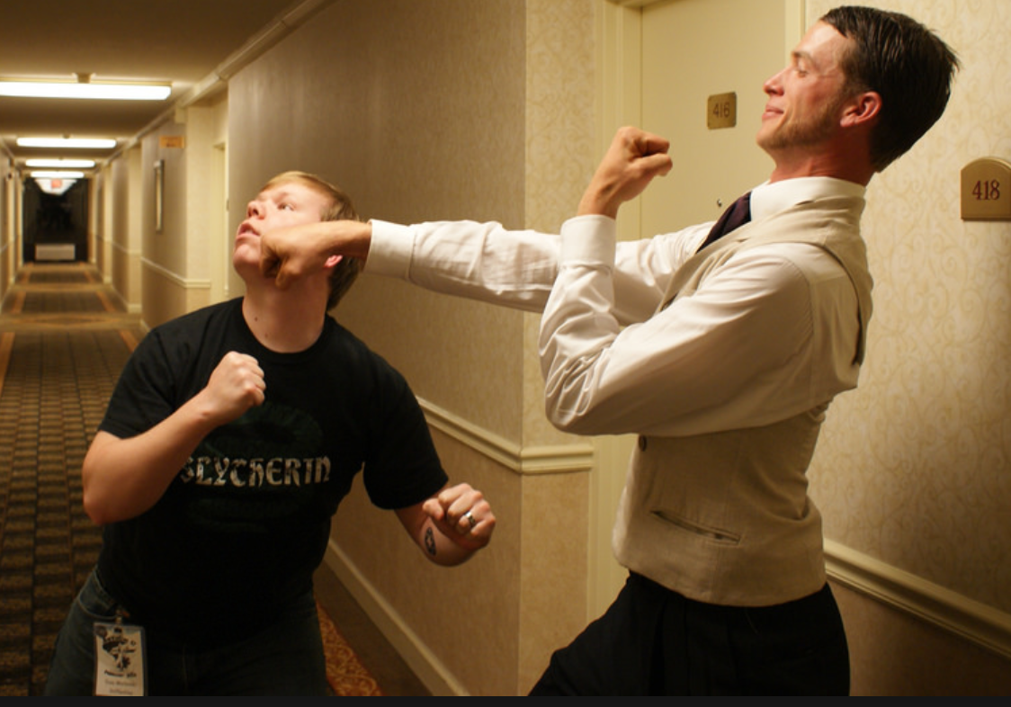
Agenda
X
Review
Collaborating with GitHub
Conflicts
Hands on conflicts
Branching and merging
Tags

Slide 3
Review
How do I...
view the change history for the repository?
see what files in the directory are modified from the last commit?
examine the changes between modified files and the last commit?
place a modified file into the staging area?
move the staged files into the repository history?

Slide 4
Review
What is...
the master branch?
HEAD?
HEAD~3?
How do I restore a previous version of a file? What verb?

Slide 5
Review
What do the following verbs do?
Push
Clone
Pull

Slide 6
Previously…
Created a local repository
What command was that again?
Added some files, committed them
Linked the repository to the remote
What command was that again?
Nice remote backup, but…

Slide 7
Collaborating
Get into your project teams
Identify someone to“own” the project repository, or create it in uwdirect-2018
Add the other team members as collaborators to the repository
Everyone clone away!

Slide 8
Collaborating
Everyone make changes to the README.md
Status, diff, add, commit, push
What happens?

Slide 9
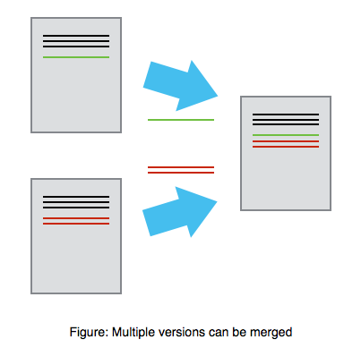
Mary
Alice

Slide 10
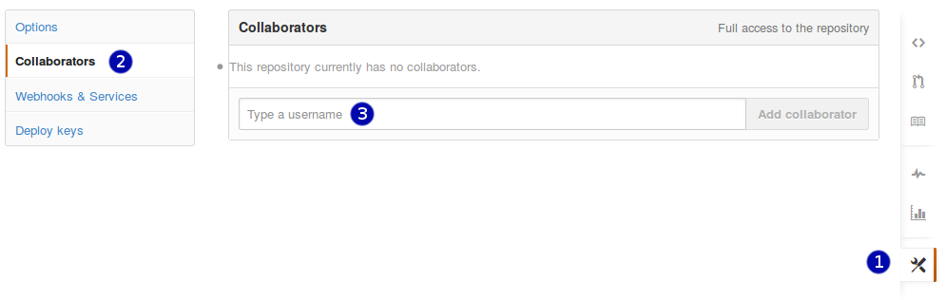
Collaborating
To add collaborators to a repository
Go to the repo
Click on Settings, then collaborators

Slide 11
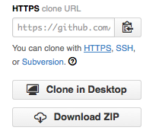

Slide 12
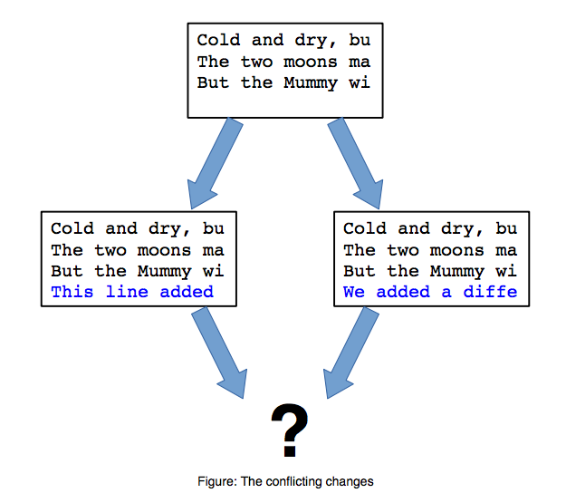

Slide 13
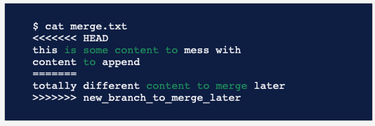
Collaborating
What happens?
Notes:
Think of these new lines as "conflict dividers". The ======= line is the "center" of the conflict. All the content between the center and the <<<<<<< HEAD line is content that exists in the current branch master which the HEAD ref is pointing to. Alternatively all content between the center and >>>>>>> new_branch_to_merge_later is content that is present in our merging branch.

Slide 14
Collaborating
What happens?
How would this work for lots of people at once?

Slide 15
Collaborating in style: Branches
Scenario
Main development trunk of codebase
Bug comes in via issue report on GitHub
You need to work on the bug but don’t want to screw up main development trunk
What to do?

Slide 16
Collaborating in style: Branches
What to do?
Branch!
Does the name master make more sense now?
NOTE! Talk about the main vs. master change and git vs GitHub.

Slide 17
Branches: commands
Making a new branch
git branch <branch-name>
Deleting a branch
git branch –D <branch-name>
Switching to a branch (or master)
git checkout <branch-name>
git checkout master
Making a new branch and switch in one
git checkout –b <branch-name>

Slide 18
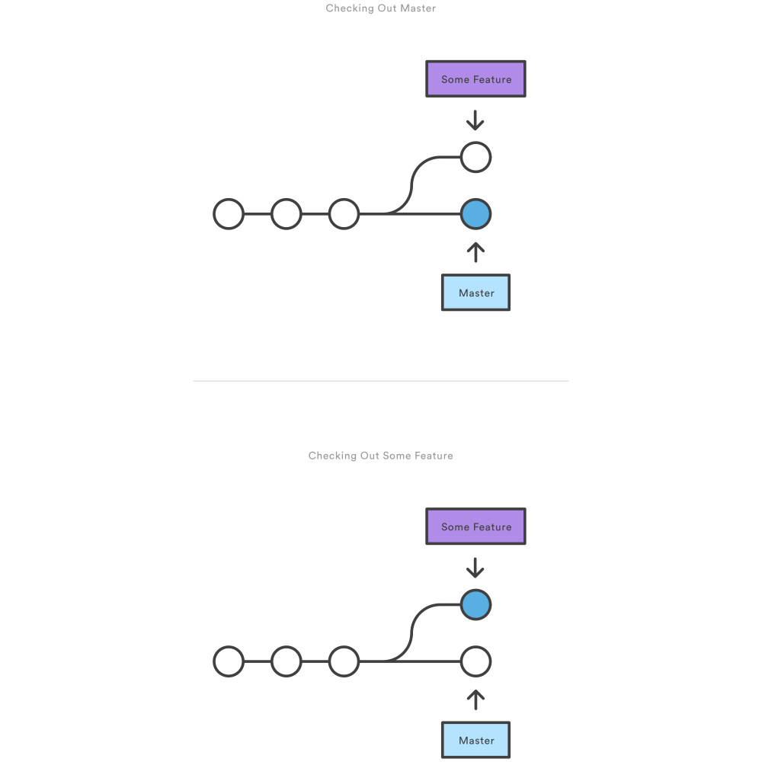
Branches: visual
After branch create
After checkout

Slide 19
Merges
But how to get our features back to master?

Slide 20
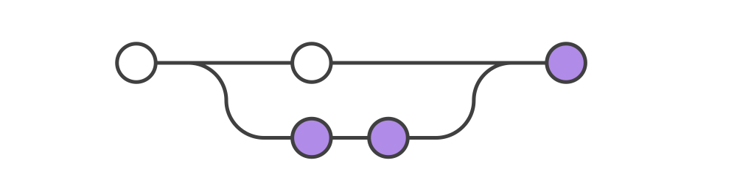
Merges
git merge <branch-name>

Slide 21
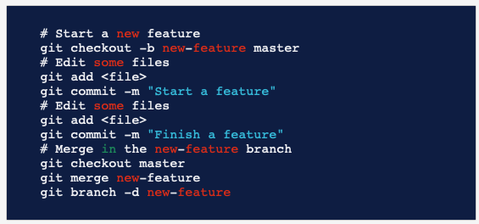
Branch workflow

Slide 22
Collaborating
In class exercise...
Get into your project teams
Each of you will create a branch, switch to it
Make changes to the branch in the README.md
Add, commit, push...
What happened?
Checkout the master branch
Merge your changes back into master

Slide 23
Collaborating
In class exercise...
Use GitHub to view branches
Use merge to resolve conflicts
Who merged? Did you both try?

Slide 24
Yet another solution!
Use a fork!

Slide 25
Yet another solution!
Conflict management with forks

Slide 26
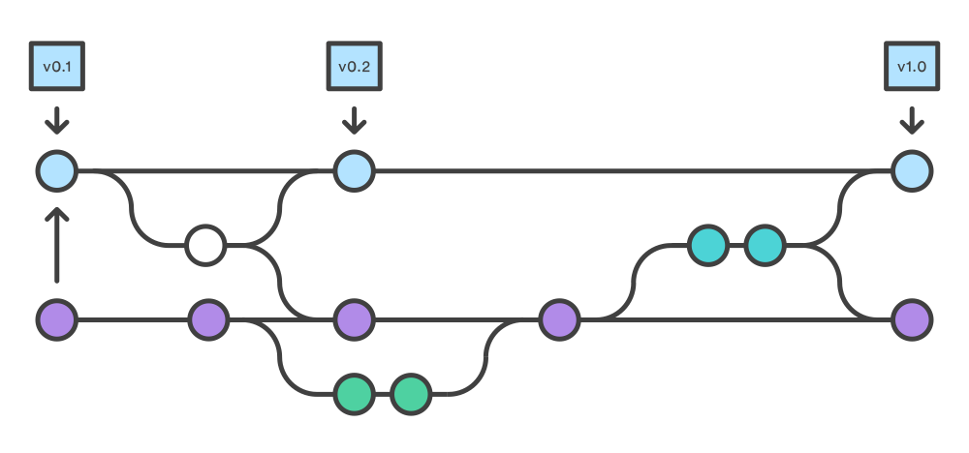
Yet another solution!
Use a fork!

Slide 27
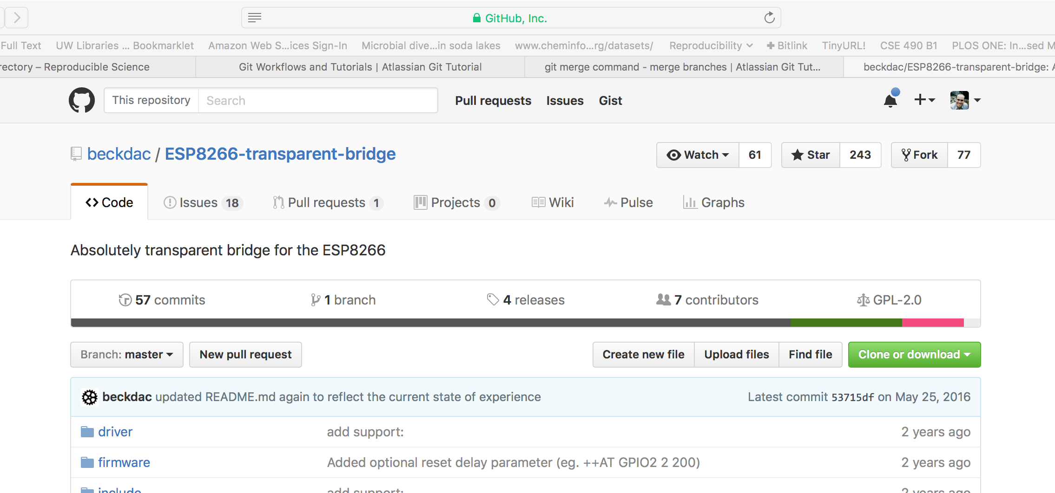
Forking a repository
Go to the repository page...
Click fork in the top right corner

Slide 28
Forking a repository
Go to your repository list
Select the `copy` or fork of the original repository
Clone your fork (not the original)
Make changes
Add, commit, push
https://help.github.com/articles/creating-a-pull-request/

Slide 29
Collaborating
In class exercise...
Get into project teams
Fork your project repo ----- CAN YOU?!!
Make a change, add, submit, commit
Submit a pull request
Someone – NOT YOU – reviews and accepts the fork
Look at changes on GitHub

Slide 30
Collaborating
Workflow differences?
Collaboration
Branches
Fork / pull request

